Slide 1

YTP Controller – Part 2
Mar 2018

Slide 2
Goals
Success Criteria
Understand how multiple buttons work as INPUTs
Understand how to add more components to respond to button input
Understand what you can build with an Arduino
Create a multiple button circuit that reads input from a button
Add LEDs to respond to button presses

Slide 4
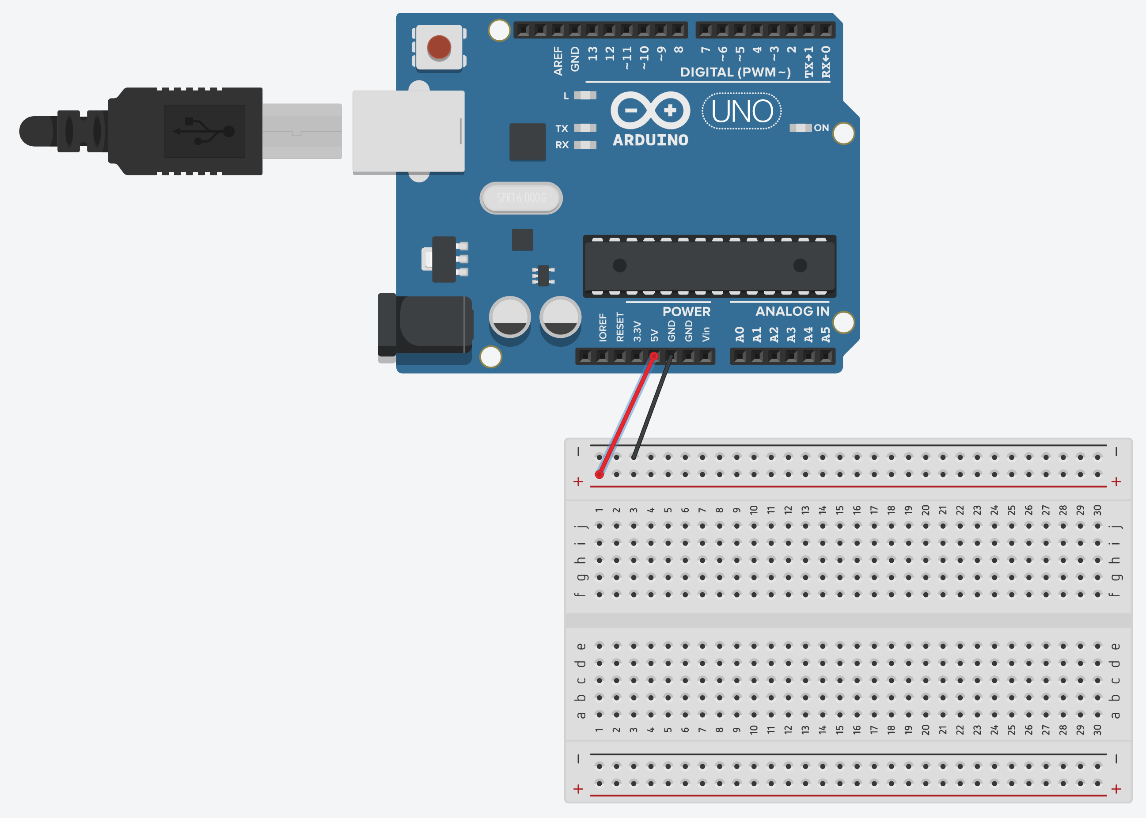

Slide 5


Slide 6
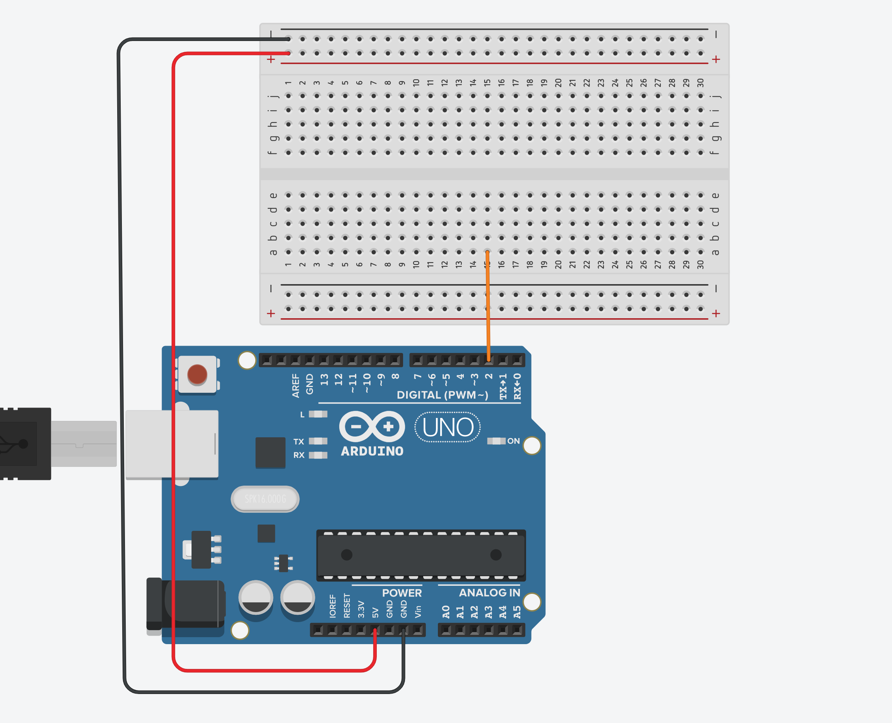
pinMode(2, INPUT)

Slide 7
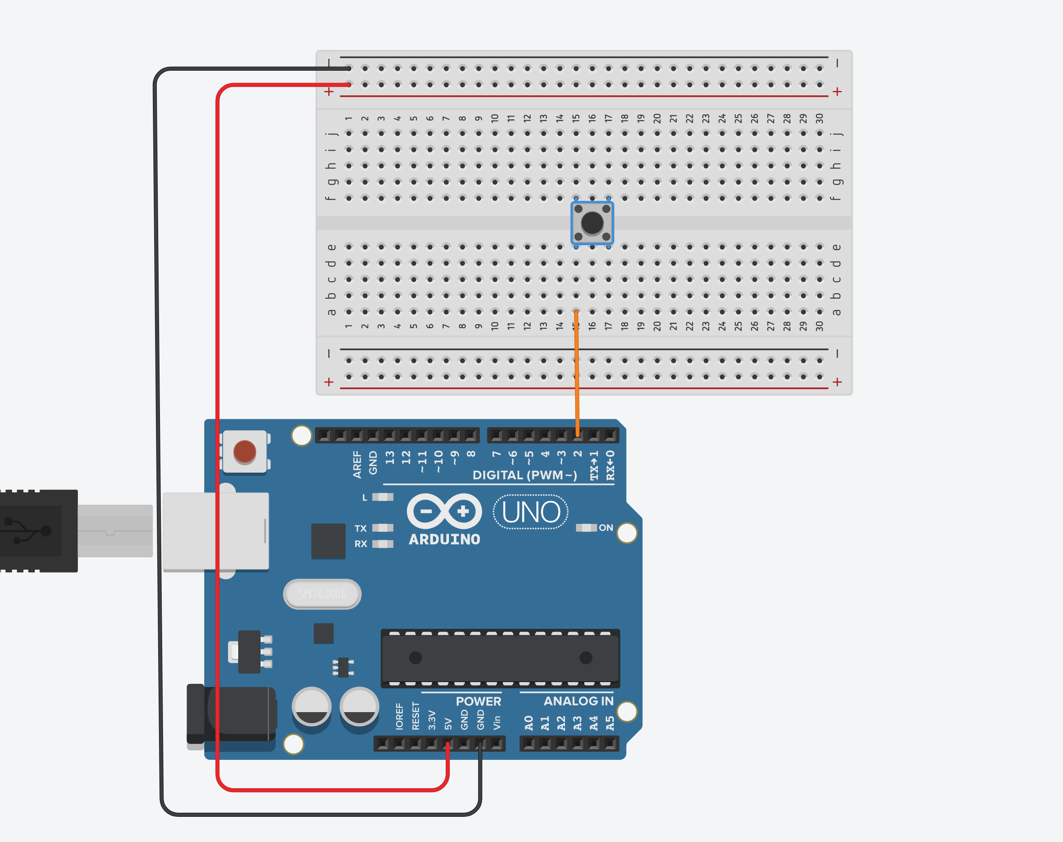
0 volts
5 volts

Slide 8
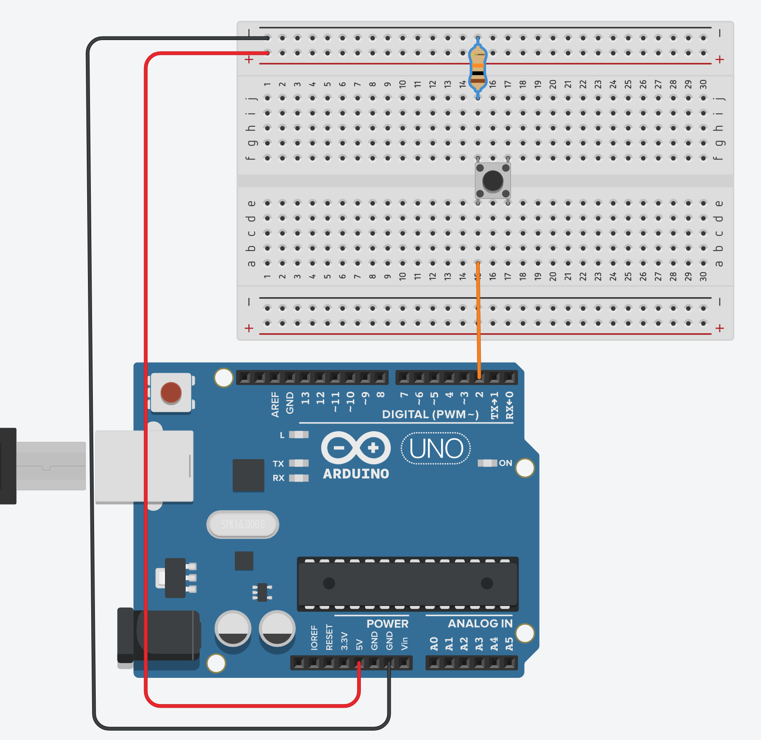
LOW
digitalRead(2) = ?

Slide 9
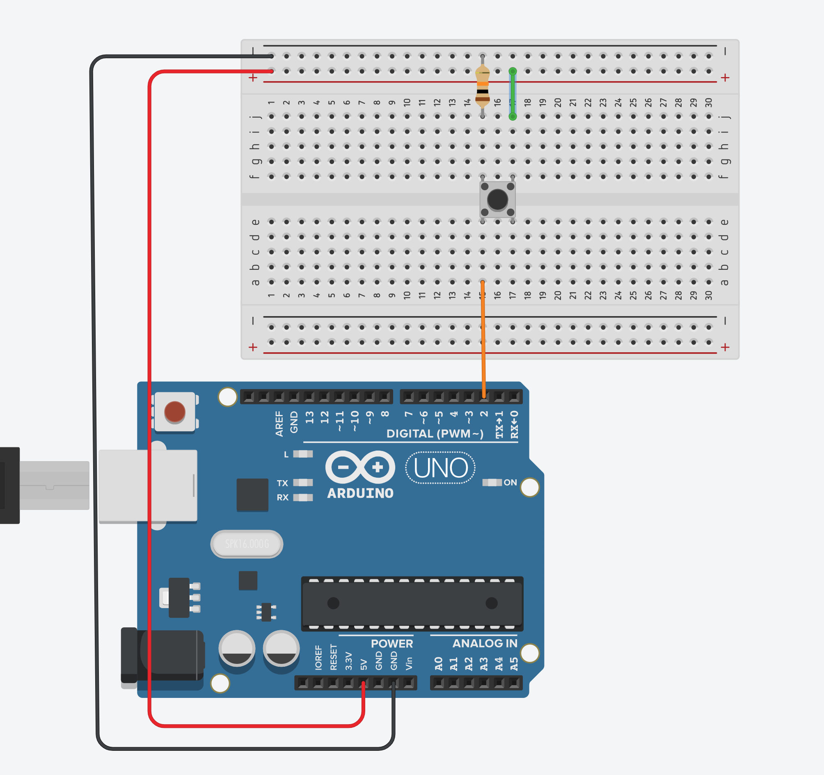
LOW
HIGH
digitalRead(2) = ?

Slide 10
LOW
HIGH
digitalRead(2) = ?

Slide 12
Run the Code
Open the ‘button-test’ sketch
Upload the sketch to your Arduino
Open the Serial Monitor (Tools -> Serial Monitor)
Set the speed to 9600
Press the button – what happens in the Serial Monitor?
Why?

Slide 13
Arduino Lilypad

Slide 14
Arduino Nano

Slide 15


